Slide 1
PROXY SERVER
21AIE211 - INTRODUCTION TO COMPUTER NETWORKS
GROUP - 6B
K.Sai Niketh AM.EN.U4AIE20162
Thota Bhuvana Chandra AM.EN.U4AIE20170
N.Abhinay Reddy AM.EN.U4AIE20149

Slide 2
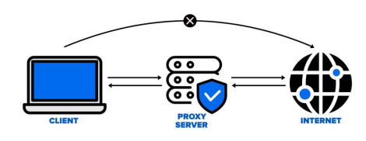
PROXY SERVER
The proxy server is a computer on the internet that accepts the incoming requests from the client and forwards those requests to the destination server. It works as a gateway between the end-user and the internet. It has its own IP address. It separates the client system and web server from the global network. The word proxy means "to act on behalf of another," and a proxy server acts on behalf of the user.
There are two main purposes of proxy server:
To keep the system behind it anonymous.
To speed up access to a resource through caching.

Slide 3
ADVANTAGES AND DISADVANTAGES OF PROXY SERVER
ADVANTAGES
DISADVANTAGES
It improves the security and enhances the privacy of the user.
It hides the identity (IP address) of the user.
It controls the traffic and prevents crashes.
Protect our network from malware.
Allows access to the restricted content.
Proxy Server Risks
Browsing history log
No encryption

Slide 4
SOCKET PROGRAMMING
Socket programming is a way of connecting two nodes on a network to communicate with each other. One socket(node) listens on a particular port at an IP, while the other socket reaches out to the other to form a connection. The server forms the listener socket while the client reaches out to the server.
They are the real backbones behind web browsing. In simpler terms, there is a server and a client.

Slide 5
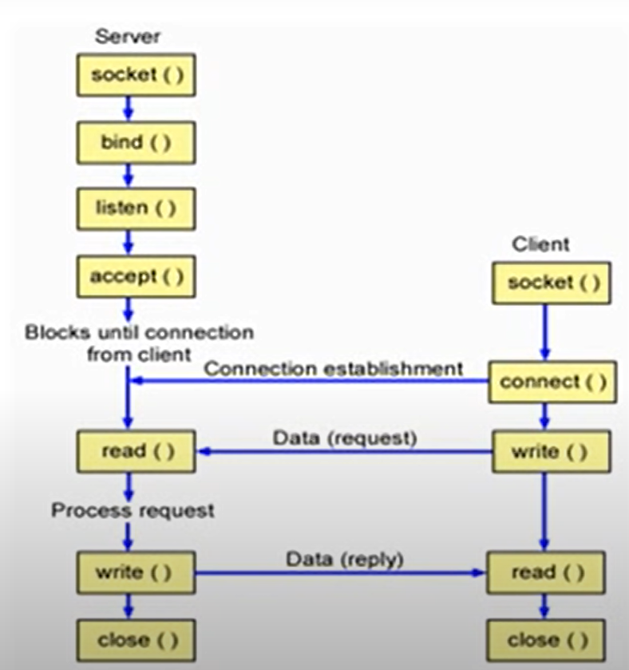
Socket is an endpoint, you can say node, machine or anything and is the 1st system call and its purpose is to activate the endpoint.
There are three parameters in the socket.(domain,type,protocol)
Binding is the next in the case of server binding means associating the address
address is a combination of IP address + port number .If you are taking IPv4, then it has 32 bit address, that is a logical address plus port number of 16 bit, so you can say you are assigning 48 bit socket address.
listen means, number is given, now the server in passive mode, the server is waiting in the passive mode
The important thing here is backlog backlog is a queue and we mention the length of queue in it and in that queue we put the requests from multiple clients, we'll put all that pending requests in the queue
When it comes in the queue and the queue is filled completely, then we will send a message to the client that our queue is full, the connection can't be made now, please try after sometime

Slide 6
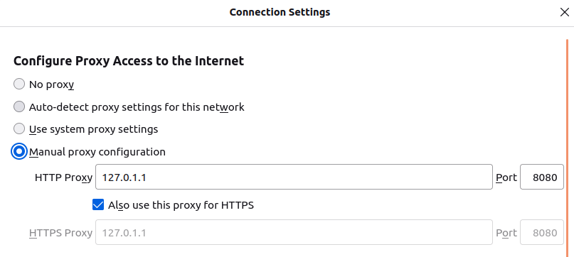
IMPLEMENTATION OF PROXY SERVER-
Step 1 -
The proxy acts as the man-in-middle between client which is our browser and the web server to which the request (HTTP or HTTPS) is sent. To use the proxy, we will have to set it in the browser proxy setting with IP 127.0.1.1 at port 8080.

Slide 7
IMPLEMENTATION OF PROXY SERVER-
Step 2 -
Before running the proxy, we have to make sure that no other process is running on port 8080. To do that, open terminal and type: sudo lsof -t -i tcp:8080 | xargs kill -9
Step -3
We run proxy.py then the object of the class server is created by which we are able to access the methods of the class. The function server( ) triggers the proxy server. Now, the proxy checks if the requested website is blocked or not. For port 80 it will call HTTP() function and for port 443 it will call HTTPS() function. If the website is requested more than once, the proxy will automatically cache it. This whole process is displayed on terminal with current date and time.

Slide 8
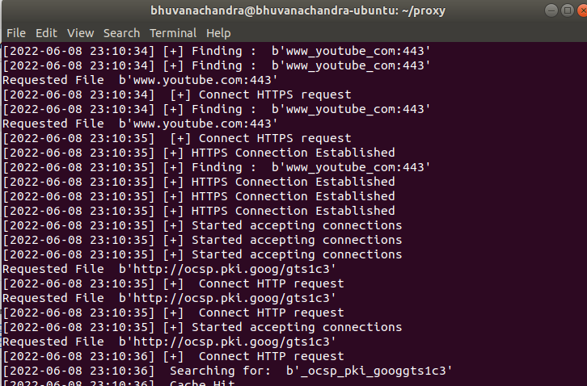
Results :
Output:

Slide 9
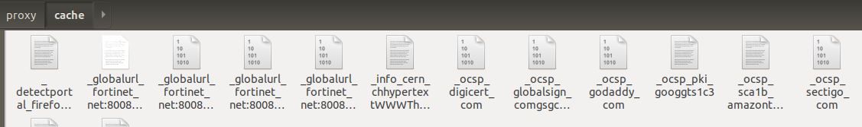
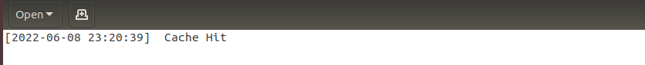
Results :
Cache :
Log file :

Slide 10
REFERENCES
https://www.fortinet.com/resources/cyberglossary/proxy-server#:~:text=A%20proxy%20server%20is%20a,web%20pages%20they%20visit%20online
https://www.pcmag.com/encyclopedia/term/proxy-server
https://www.geeksforgeeks.org/socket-programming-cc/#:~:text=Socket%20programming%20is%20a%20way,reaches%20out%20to%20the%20server
https://www.tutorialspoint.com/unix_sockets/what_is_socket.htm

Slide 11
Thank You

